Slide 1
Forklift and Pallet Detection
PETROCHOICE · AI ENGINEER CANDIDATE · ROUND 2 TASK
Objective: an object detector that finds forklifts and pallets in warehouse images, built with YOLO11
Rana Nasser
Notes:
Introduce yourself in one sentence, then the plan: the task, the approach, how the data was handled, the results, and what you would do next. Say up front that the main effort went into data quality, because that limits accuracy more than the choice of model.

Slide 2




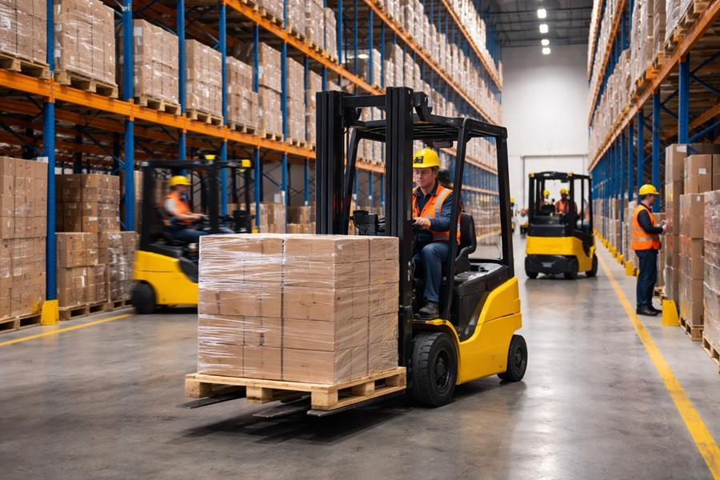
What a forklift and pallet detector enables
WHY IT MATTERS
Safety
Automation
Inventory
Efficiency
Warn when a forklift enters a walking zone
Guide autonomous forklifts to the right pallet
Count pallets without manual stock checks
Measure forklift use and dock activity
Forklift and Pallet Detection · 2
Notes:
Start with the business value, not the model. Safety: knowing where forklifts are relative to people and walkways. Automation: an autonomous forklift needs to find and approach pallets. Inventory: counting pallets and vehicles from camera feeds. Efficiency: how long forklifts are idle or busy. All of these need the same first step, which is a reliable detector.

Slide 3
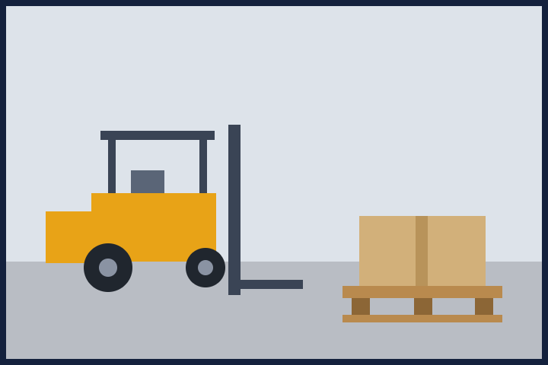
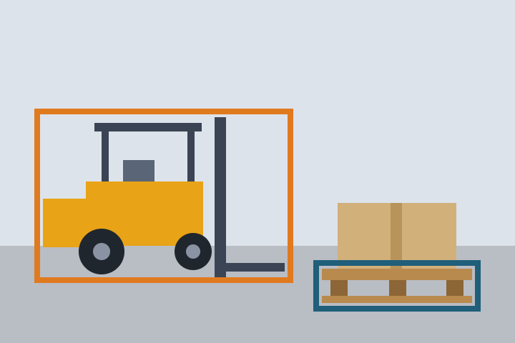
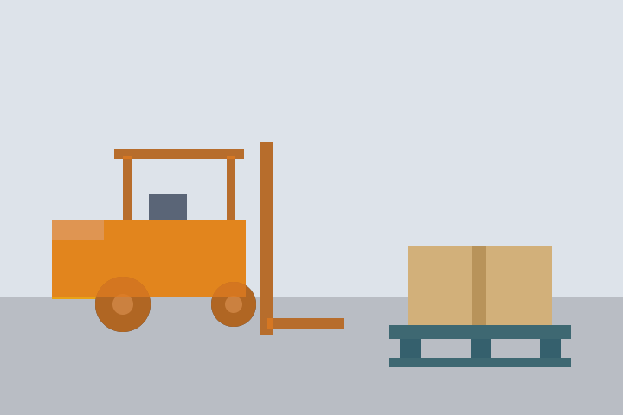
Our problem is detection: what is where
TASK TYPE
Classification
Detection
Our task
Segmentation
What is in the image? One label for the whole image, no position.
What is where? A box, a class and a confidence for each object.
Which pixels belong to each object? Slower, and labels cost far more.
Forklift and Pallet Detection · 3
Notes:
Classification says what is in the picture, but a warehouse image always contains both classes, so one label is useless. Segmentation gives exact outlines, but labeling masks costs many times more than boxes and the model is slower. We need to count objects, know where they are and track them, and a box is enough for that. That is why this is a detection problem. If we later needed exact pallet pockets or floor space, segmentation or oriented boxes would be the next step.

Slide 4
Detect forklifts and pallets in warehouses
THE TASK
Input
Output
Classes
Warehouse images and video frames
A box, a class and a confidence for every object
forklift and pallet, empty or loaded
Why it is hard
Small, distant and partly hidden pallets
Look-alikes: pallet trucks, stillages, small load carriers
Public data that may not match the target warehouse
Forklift and Pallet Detection · 4
Notes:
The system takes an image or a video frame and returns, for each object, a class, a box and a confidence score. Only two classes matter. Pallet trucks, stillages and small load carriers look similar, so they are a source of confusion and I deliberately treat them as background. The biggest uncertainty is that public datasets may not look like Petrochoice's cameras.

Slide 5
A single-stage YOLO11 detector, fine-tuned from COCO
APPROACH
Option | Strength | Trade-off
Two-stage (Faster R-CNN) | Strong accuracy, good on small objects | Slower and heavier to deploy
Transformer (RT-DETR) | No NMS step, strong accuracy | Heavier, needs more data and compute
YOLO11 (chosen) | Real-time, mature tooling, COCO weights, simple ONNX export | Less accurate on tiny objects than larger models
Tools: Python, Ultralytics YOLO, PyTorch, Kaggle Notebooks, with transfer learning from COCO weights. YOLO11n is the lightweight baseline and YOLO11s is compared against it. The choice is revisited on accuracy, speed and hardware.
Forklift and Pallet Detection · 5
Notes:
Why a detector and not segmentation: the output needed is a box with a class and a confidence, and boxes are enough for counting and zone rules. Why YOLO11: it is real-time, well supported, starts from COCO weights that already know vehicles, and exports to ONNX easily. Faster R-CNN and RT-DETR are valid alternatives; I would try RT-DETR if accuracy mattered more than speed. A 3D pipeline was not needed because there is no depth requirement in the task.

Slide 6
Two datasets, filtered to two classes
DATA
Sources
Filtering rules
Warehouse (Roboflow Universe): 1,075 images, 5 classes. 11,776 pallet boxes but only 5 forklift boxes in train.
Exact name match: pallet_truck is never pallet
Removed classes become background
Images with only removed classes: a capped sample (80 images) kept as hard negatives
Untrusted images dropped (empty or missing labels)
Polygons turned into YOLO boxes, output verified from disk
Audit sheets reviewed: 174 overlap flags, 80 negatives
Forklift (Kaggle): 1,011 images, classes forklift and person. 1,000 forklift boxes in train, no pallets.
Merged with a source prefix on every file name. Labels are checked before any training, because wrong or missing labels cap accuracy.
Forklift and Pallet Detection · 6
Notes:
The original datasets are never modified; a separate processed copy is written. A pallet truck looks like a forklift, so some images that only contain removed classes are kept as hard negatives, but capped at 10% because a pallet under a stillage may be unlabeled in the source. Every image is checked: label file present, class ids valid, boxes inside the image. The script prints a report and flags suspicious cases, such as a source that barely annotates a class, and saves audit images for a visual check. Dataset licenses should be checked before any commercial use.

Slide 7
A test set carved without near-duplicate leakage
DATA SPLITS
1,660
213
187
train images
validation images
test images
The sources have no usable test split, so one is carved from train
Near-identical frames are grouped by a difference hash and stay together
Near-duplicates are then removed from train (21) and validation (2)
Forklift and Pallet Detection · 7
Notes:
If a near-identical frame of a test image sits in train, the test score looks better than it is. Frames from one video or scene are clustered with a 64-bit difference hash, and a whole cluster goes either to test or stays in train. The hash only catches near-identical frames, so the test numbers are still optimistic for a new warehouse. I say this openly in the limitations.

Slide 8
Two problems in the data, two fixes
DATA PROBLEMS
Class imbalance
Labels missing across sources
11 : 1
0
pallet boxes per forklift box in train (10,347 and 905)
pallet boxes in the forklift dataset. The warehouse dataset has only 5 forklift boxes.
Fix: repeat forklift images up to 3 times. No data is thrown away, and AP is reported per class.
Fix: self-training. A first model adds confident labels (0.6 or more) to the train split only, and a sample is checked by eye.
Forklift and Pallet Detection · 8
Notes:
I did not undersample pallets, because that throws away good examples. Repeating forklift images keeps all the data, and augmentation makes each repeat look different. The second problem is subtler: a pallet visible in a forklift-dataset image is unlabeled, so it counts as background and teaches the model the wrong thing. Pseudo-labels reduce this. They are model guesses, so I only add confident ones, only to train, and I look at a sample. Validation and test labels stay human-made.

Slide 9

YOLO11: one pass from image to boxes
ARCHITECTURE
Backbone
Neck
Head
Input
Convolution blocks and attention extract features
Anchor-free box and class branches, then NMS
Image resized to 768 px
Mixes features from three scales
Keeps small pallets visible
Small pallets and big forklifts in one model
COCO weights already know vehicles
No anchor tuning, one pass
Why YOLO11: real-time speed, simple ONNX export, and COCO pretraining lets fine-tuning work with about 2,000 images.
Forklift and Pallet Detection · 9
Notes:
Walk left to right. The backbone turns pixels into features; because it starts from COCO weights, it already recognizes vehicles, edges and boxes, so fine-tuning needs far less data. The neck combines features from three scales, which matters here because forklifts are large and pallets are often small and far. The head predicts boxes and class scores directly, without anchor boxes, so there is no anchor tuning; NMS then removes duplicate boxes. It is single-stage, so one forward pass is enough for real-time use. A transformer such as RT-DETR is a valid alternative but heavier.

Slide 10
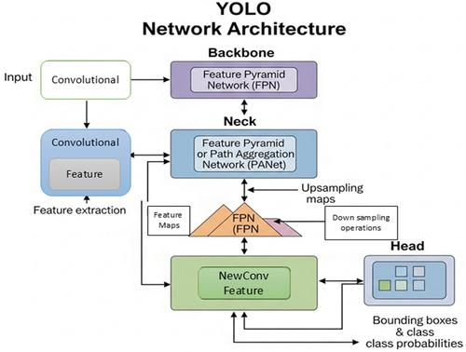
YOLO11: one pass from image to boxes
ARCHITECTURE
Forklift and Pallet Detection · 9
Notes:
Walk left to right. The backbone turns pixels into features; because it starts from COCO weights, it already recognizes vehicles, edges and boxes, so fine-tuning needs far less data. The neck combines features from three scales, which matters here because forklifts are large and pallets are often small and far. The head predicts boxes and class scores directly, without anchor boxes, so there is no anchor tuning; NMS then removes duplicate boxes. It is single-stage, so one forward pass is enough for real-time use. A transformer such as RT-DETR is a valid alternative but heavier.

Slide 11
Same data, two model sizes, one honest selection
TRAINING
Models
Settings
YOLO11n and YOLO11s, COCO-pretrained, fine-tuned on the merged data
768 px images, up to 80 epochs, early stopping, cosine learning rate, fixed seed
Augmentation
Selection
Mosaic off for the last 10 epochs. No vertical flip, because an upside-down forklift is unrealistic
Model and confidence threshold are chosen on validation. The test set is used once.
Forklift and Pallet Detection · 10
Notes:
Image size went up from the usual 640 because the objects that get missed are small. Training length was extended because the validation curve was still rising slowly at 60 epochs and early stopping had not triggered. The point I want to stress is the discipline: every choice (model size, confidence threshold) is made on validation, and the test set is touched once for the final number.

Slide 12
How the model is judged
EVALUATION STRATEGY
Precision
Recall
mAP@50
mAP@50-95
Of the boxes drawn, how many are real objects
Of the real objects, how many were found
A box counts if it overlaps the label by at least 50%
Averaged over stricter overlaps up to 95%, so tight boxes score higher
Separate train, validation and test sets, with near-duplicates removed across them
Each class is evaluated on its own
False positives and false negatives are analyzed image by image
The model is chosen on validation, and the test set is used once
Forklift and Pallet Detection · 11
Notes:
Precision and recall describe the trade-off between false alarms and misses. mAP summarizes precision across confidence thresholds; mAP@50 is lenient about box position, mAP@50-95 is strict. Overall accuracy would hide a weak minority class, which is why every metric is also reported per class. The model is selected by measured validation performance, not by assumption, and the test set is touched only once for the final number.

Slide 13
Both sizes reach mAP50 above 0.85 on the test set
RESULTS
Model | Split | mAP50 | mAP50-95 | Precision | Recall
YOLO11n | val | 0.851 | 0.468 | 0.911 | 0.769
YOLO11n | test | 0.883 | 0.531 | 0.863 | 0.799
YOLO11s | val | 0.858 | 0.474 | 0.881 | 0.817
YOLO11s | test | 0.856 | 0.512 | 0.822 | 0.812
Per class, test AP50 (YOLO11s): forklift 0.868, pallet 0.844. The two sizes are within noise of each other, so YOLO11n is the better value: about 11 ms against 17 ms per image in the validation runs.
Forklift and Pallet Detection · 12 · first run, 640 px, before class balancing
Notes:
Read the table in this order: validation is where the model was chosen, test is the one-time final number. Test is higher than validation for YOLO11n, possibly because the test set is small (about 100 forklift boxes), so differences of a few points are noise. I do not pick the winner by the test score, because that would leak the test set into the choice. mAP50 asks whether the object was found roughly in the right place; mAP50-95 is stricter and rewards tight boxes, which is why it is much lower. UPDATE THIS SLIDE with the numbers from the final run (768 px, class balancing, pseudo-labels) before presenting.

Slide 14
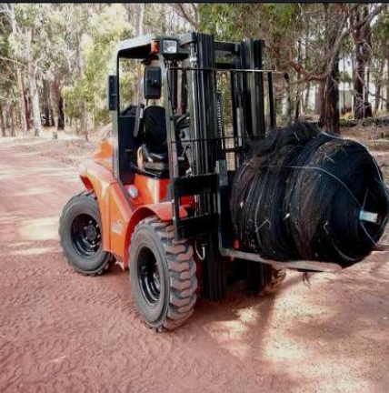
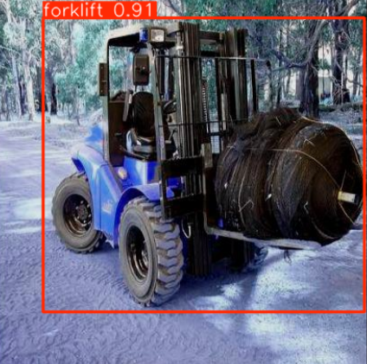
Predictions next to the labels
VISUAL RESULTS
Source: s0_forklift
Image: rep1_s0_forklift__01FVZIGPUGWI_jpg.rf.272f9ea3336a11f2c4390ccc97244242.jpg
Detections: 1
Class: forklift | Confidence: 0.907
Forklift and Pallet Detection · 13
Notes:
Replace the two frames with real images from the final run. The notebook draws labels as solid boxes and predictions as dashed boxes, with the class and confidence on each. Pick two or three frames where the model is right, and two or three where it fails, and say in one sentence why it failed (small, occluded, look-alike equipment, or an unlabeled object). Do not show numbers here that are not in your results.

Slide 15
Where the model still fails
ERROR ANALYSIS
1,020
349
198
0
correct detections
false alarms
missed objects
forklift and pallet mix-ups
Missed objects are small: median area 0.16% of the image, against 0.42% for all boxes
The two classes are never confused with each other
Many false alarms are probably real pallets that were never labeled, which is checked per source
Forklift and Pallet Detection · 14 · YOLO11s, test split, confidence 0.25, IoU 0.5 (first run)
Notes:
This is the slide that shows I looked at the failures and not only at the metrics. The model never calls a forklift a pallet or the reverse. Misses are mostly tiny objects, which is why the final run uses a larger image size. The false alarms look high, but in this dataset each source labels only one class, so a pallet visible in a forklift-dataset image counts as a false alarm. The notebook measures that per source and shows the images. UPDATE THIS SLIDE with the final run and add the confusion matrix picture from section 7 of the notebook.

Slide 16
Measured speed, proposed deployment
DEPLOYMENT: MEASURED AND PROPOSED
134 ms
0.501
18 ms
per image on CPU with ONNX (7.5 FPS)
ONNX mAP50-95, against 0.512 in PyTorch
per image in the YOLO11s validation run
ONNX export keeps accuracy almost unchanged and runs without PyTorch
ByteTrack gives stable IDs across video frames, so one pallet is not counted twice
Measured on Kaggle, not on target hardware
Proposed, not built: a FastAPI service for image and video requests, validated under real warehouse conditions
Forklift and Pallet Detection · 15 · first run, 640 px
Notes:
Latency is measured end to end for one image, including preprocessing and postprocessing, on CPU for both PyTorch and ONNX so the comparison is fair. A model that is too slow for the camera is not usable, so I treat speed as part of the result. These numbers are from a cloud machine, not from Petrochoice hardware. UPDATE THIS SLIDE with the final run: the larger image size makes it somewhat slower.

Slide 17
Limitations and how we handle them
CHALLENGES AND LIMITATIONS
Limitation | Effect | Mitigation
Class imbalance | About 11 pallet boxes per forklift box in train | Repeat forklift images, evaluate each class separately
Incomplete annotations | Each source labels one class, so some objects count as background | Audit reports, pseudo-labels on train only, per-source check
Domain shift | Public images differ from Petrochoice cameras, so scores may not transfer | Label real frames and fine-tune; test on real data before deployment
Similar objects | Pallet trucks and stillages can look like forklifts or pallets | Kept as background and hard negatives; class-specific error analysis
Small carved test set | Optimistic and noisy scores | Near-duplicate removal; confirm on a real test set
Assumptions: public data stands in for the target site; forklift means the vehicle and pallet means an empty or loaded pallet; cameras are mostly fixed. Check dataset licenses; Ultralytics is AGPL-3.0.
Forklift and Pallet Detection · 16
Notes:
Being open about limits is part of the answer. The biggest risk is domain shift and generalization: public images differ from Petrochoice's cameras in angle, lighting and pallet types, so the numbers are not a production guarantee. Labeling is the second risk: each source annotates only one class, which I reduce with repetition and pseudo-labels but cannot remove without human labels. Also note that the output is 2D boxes only, with no distance or approach angle, and that cameras capture people, so privacy rules apply.

Slide 18
Done so far, and what comes next
CONCLUSION
Done
Next (proposed)
Two datasets merged, filtered to two classes and audited
Train, validation and test splits without near-duplicate leakage
YOLO11n and YOLO11s trained and compared
Per-class evaluation and error analysis
Label real Petrochoice frames and review the pseudo-labels
Improve data and model iteratively, with active learning
Validate on representative warehouse data
Optimize for the target hardware, then consider deployment once targets are met
Forklift and Pallet Detection · 17
Thank you. Questions?
Notes:
Separate what is finished from what is proposed. Finished: data preparation, splits, training of two sizes, evaluation and error analysis. Proposed: real-frame labeling, iterative improvement, validation on representative data, hardware optimization such as INT8 quantization, tracking with zone rules, and depth sensing if distance is needed. Deployment is a future phase, to be considered only after the model meets defined performance requirements.

